Slide 1

Machine Learning Study: Sleep Disorders and Health
Robert Pearce, Gabrellea Norman, Spencer Bowman

Slide 2
Background
We found a dataset on Kaggle on personal habits and their relationship with sleep disorders.
300+ rows of mock data
Columns include:
Minutes of exercise per day
Cardiovascular disease
Length and quality of sleep
Weight, age, gender
Blood pressure

Slide 3
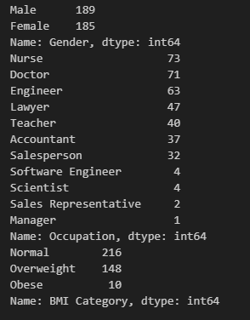

Data Profile

Slide 4
Objective
Develop a machine learning model to predict sleep health outcomes based on lifestyle factors, comprehensive sleep metrics, and cardiovascular health indicators using the Sleep Health and Lifestyle Dataset.
Key Features:
Comprehensive sleep metrics (duration, quality, stages)
Lifestyle factors (physical activity, stress levels, BMI categories)
Cardiovascular health indicators (blood pressure, heart rate)
Sleep disorder labels (Insomnia, Sleep Apnea)

Slide 5
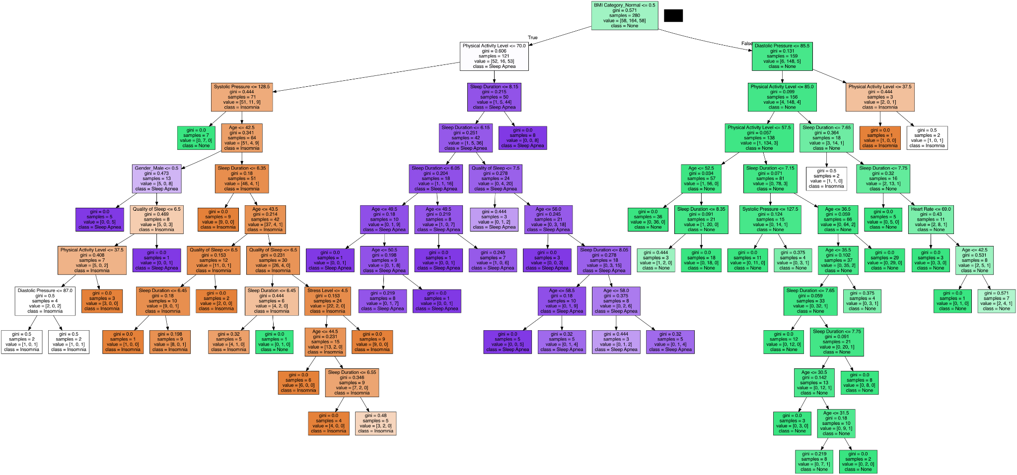
Initial Decision Tree

Slide 6
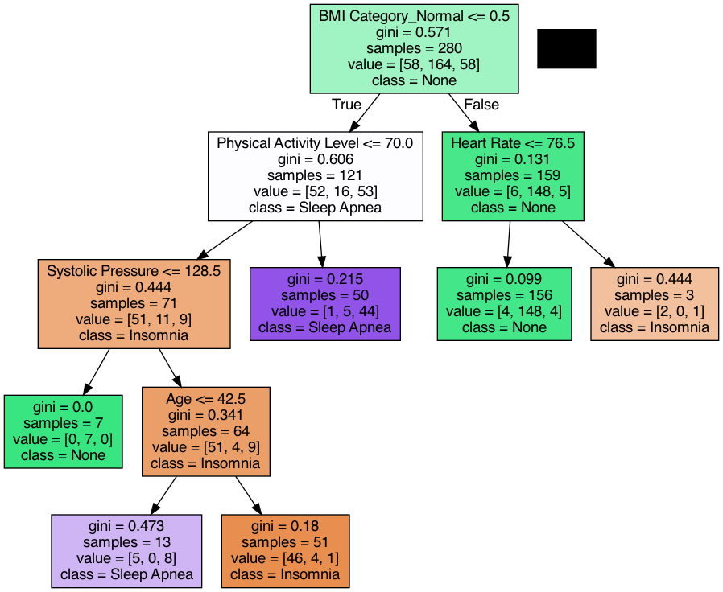


Minimum Impurity Decrease of 0.01
Gini impurity:

Slide 7
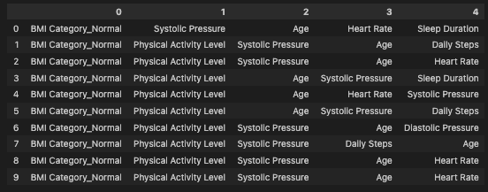
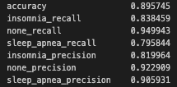

Model Evaluation
Feature Importance
Initial
Final

Slide 8
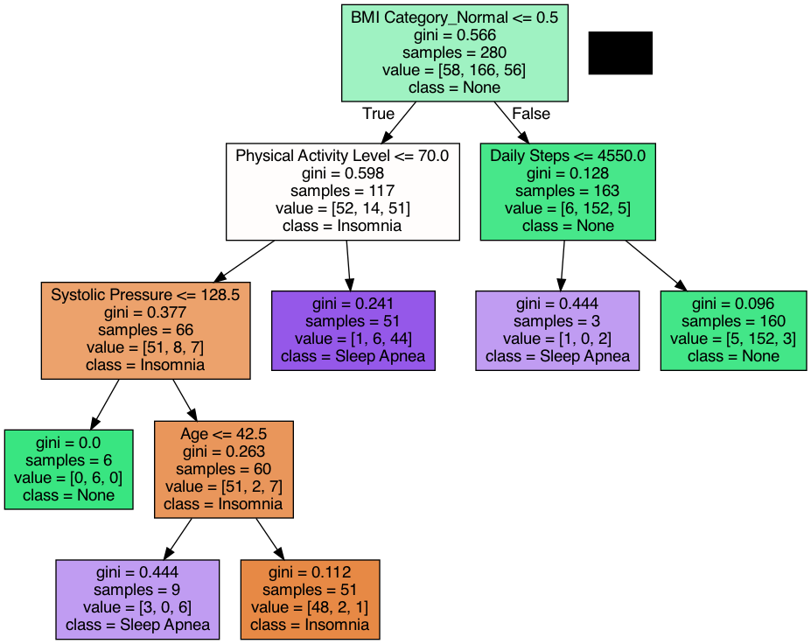
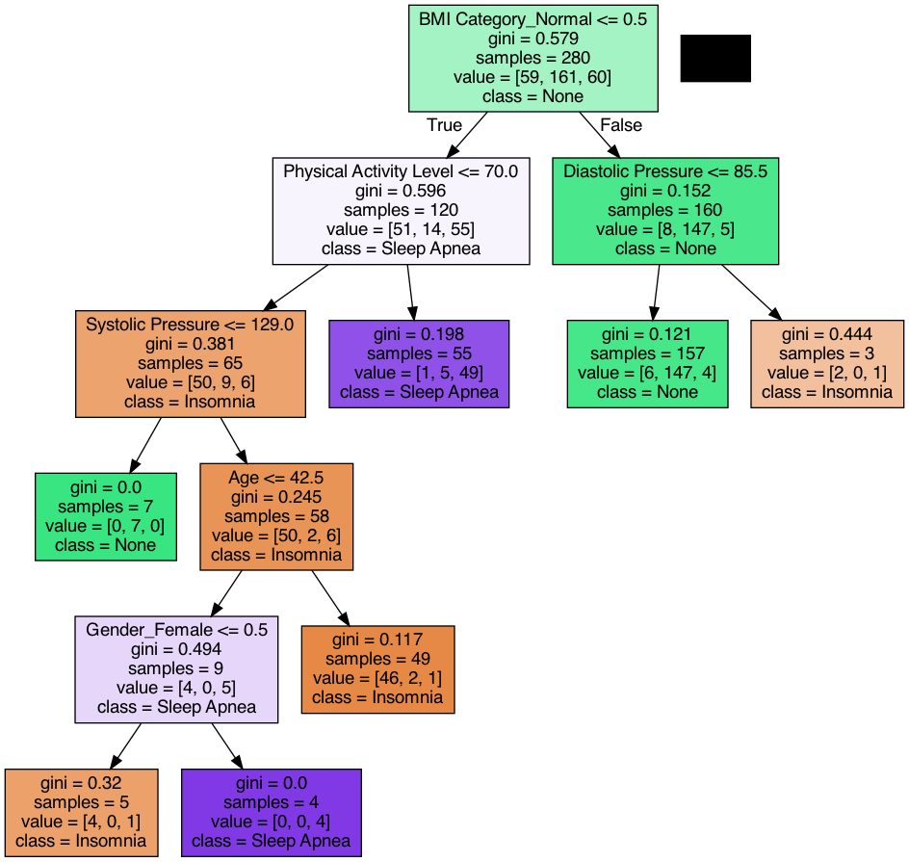
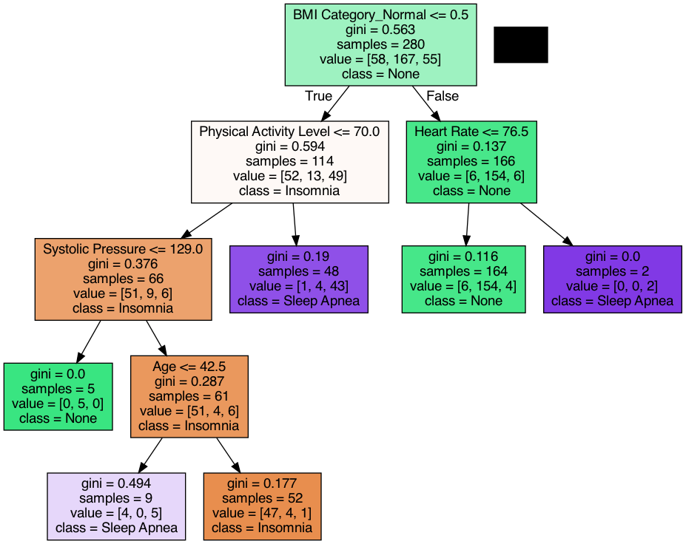
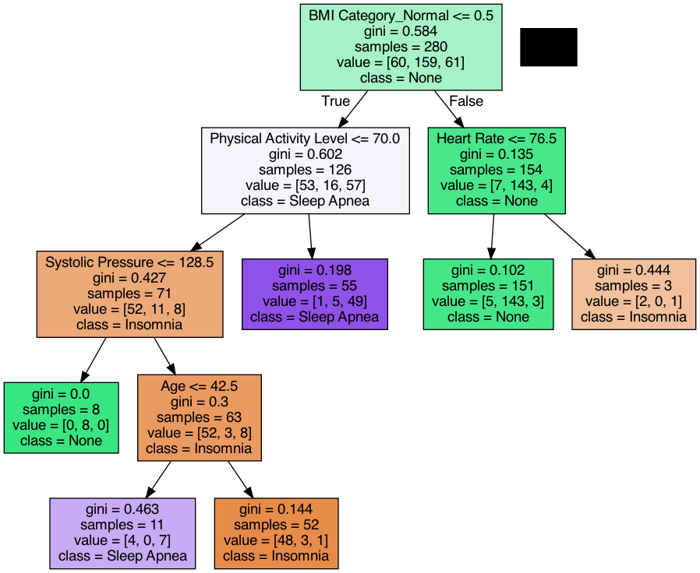

Slide 9
Decision Tree
The model first partitions the data by BMI, separating normal from disordered individuals. Then among individuals with a sleep disorder, sleep apnea and insomnia is determined primarily by physical activity level.

Slide 10
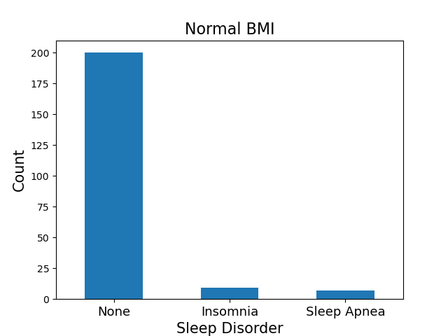
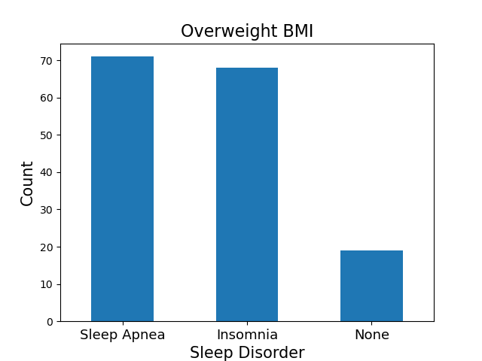
BMI Category

Slide 11
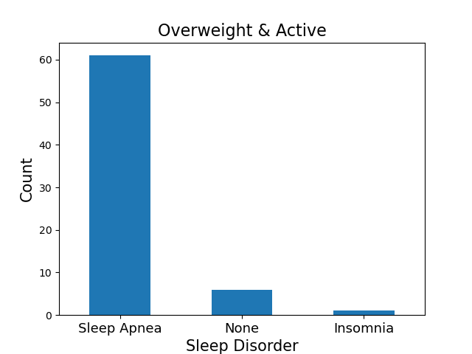
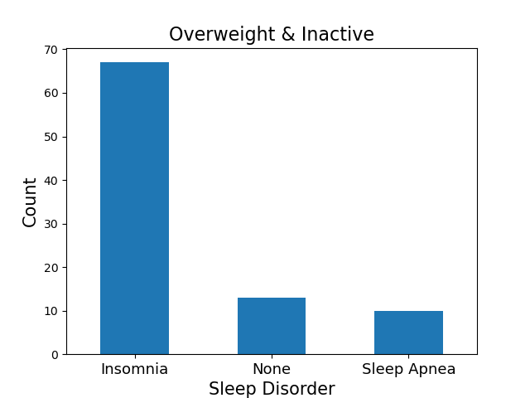
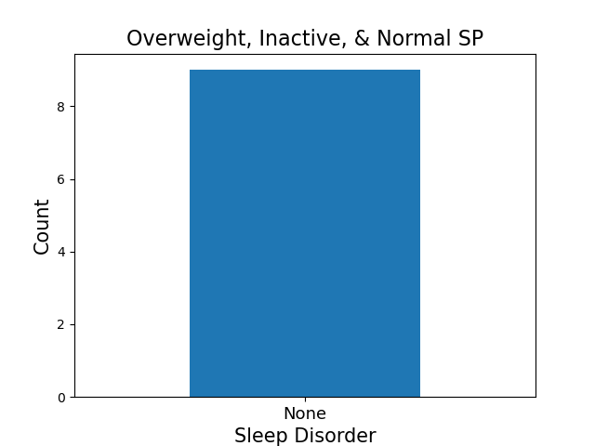
Disorder Classification

Slide 12
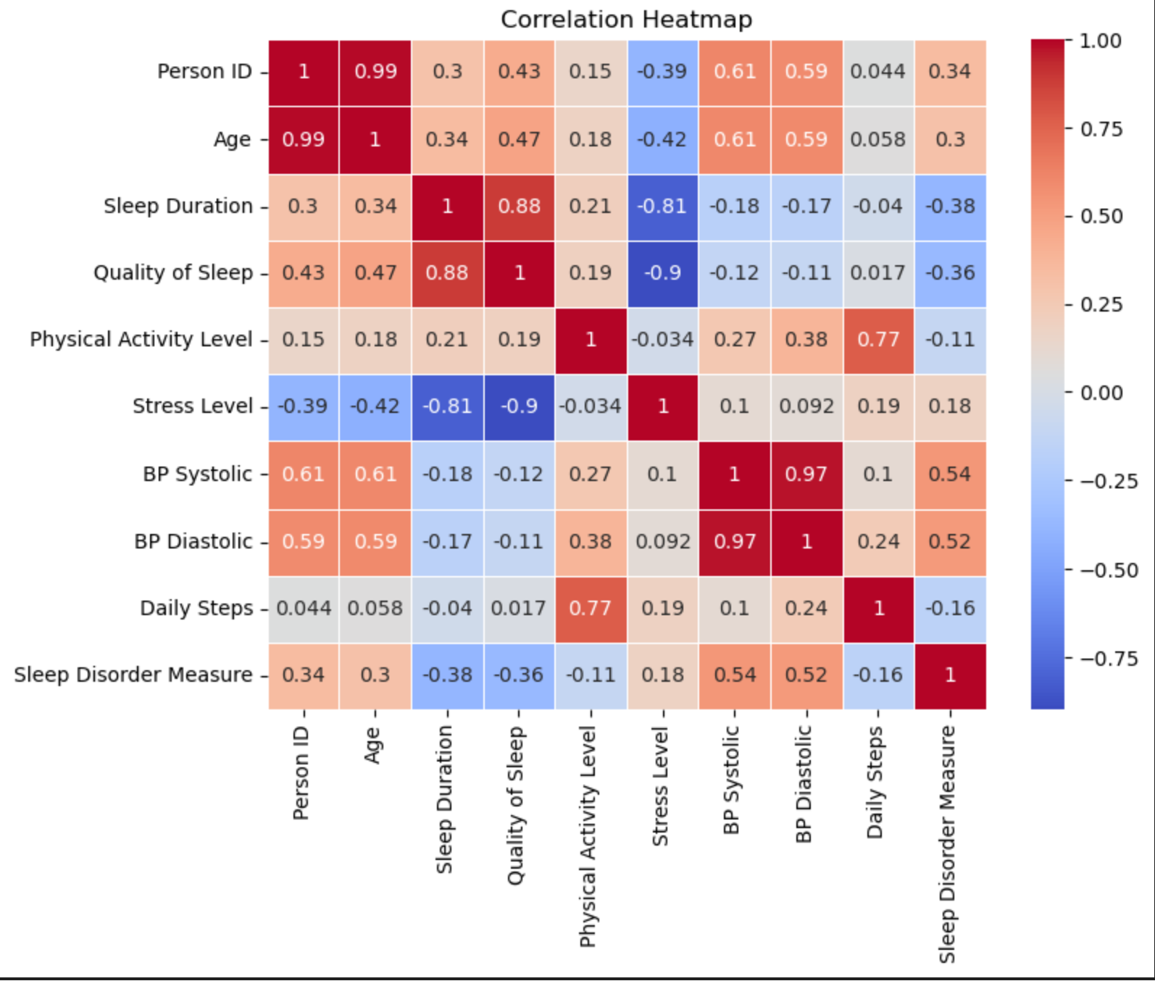
Correlation Heatmap
According to the correlation heatmap, the variables with the strongest positive correlation were quality of sleep and sleep duration, as well as physical activity level and daily steps at 0.88.

Slide 13
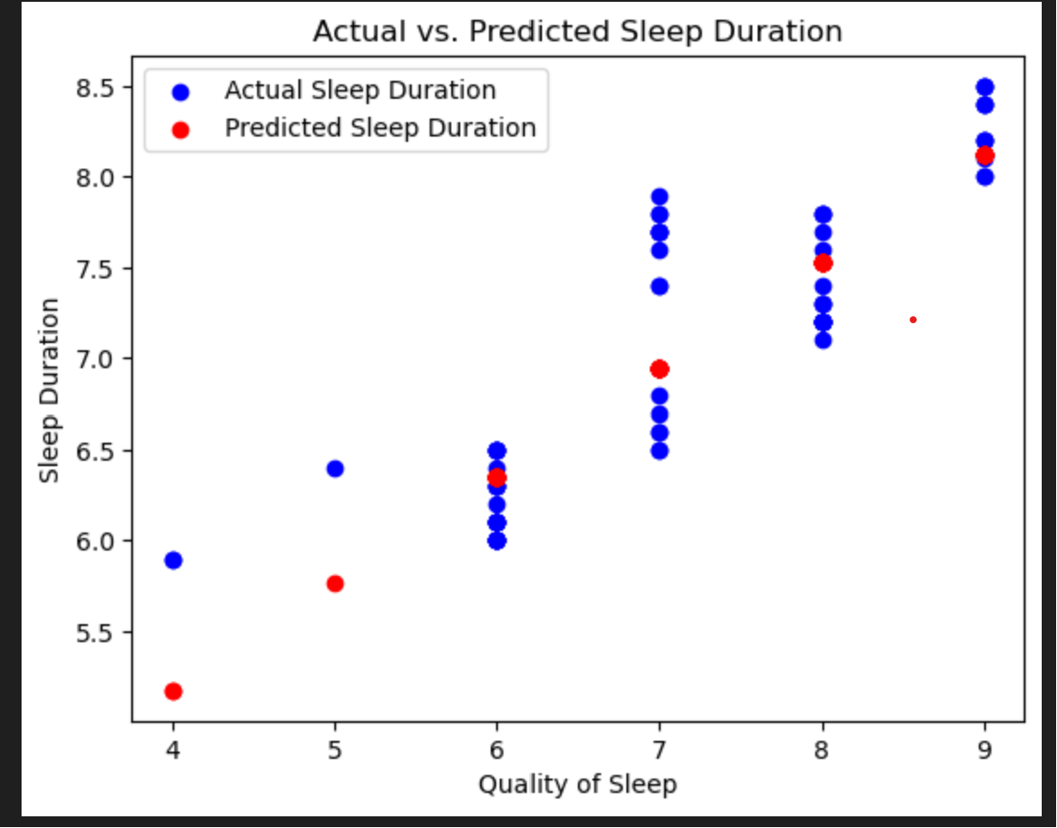
Actual vs Predicted Sleep Duration
The scatterplot illustrates a positive correlation between sleep quality and both actual and predicted sleep duration. A lower quality of sleep is associated with a shorter sleep duration, while an increase in sleep quality corresponds to an extended sleep duration.

Slide 14
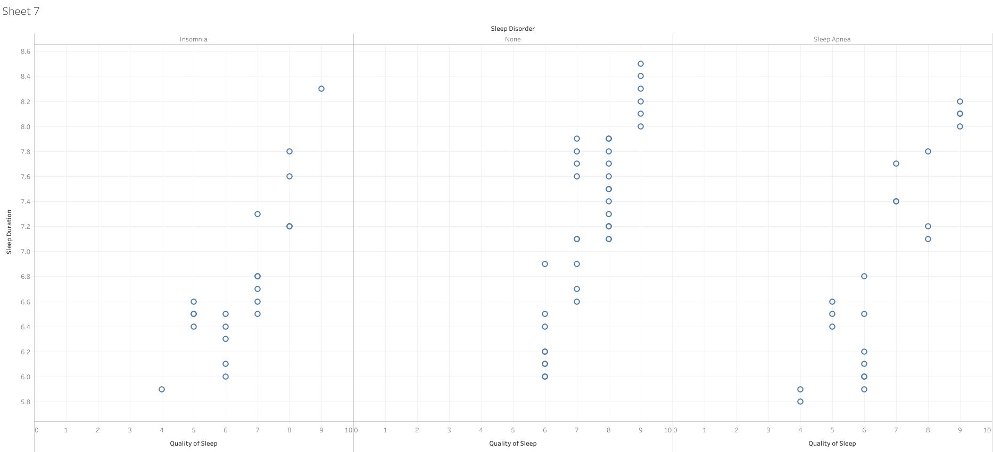
Quality of Sleep vs Sleep Duration

Slide 15
Sleep Tracking App

